Slide 1
The Efficacy of Diagnostic Imaging
Fryback, Dennis G., and John R,
Medical decision making 11.2 (1991): 88-94.
Presented by:
Yue Shi (yueshi@usc.edu)
Himani Sharma (himanis@usc.edu)
Akhil Kumar Rajendra(akhilkur@usc.edu)

Slide 2
Contents
Background
Related Work
Efficacy Model
Conclusion
References
Q&A

Slide 3
Background: Diagnosis Imaging
Definition:
It is defined as the technique or process of creating the visual representation of internal organs for clinical analysis
Types:
X-ray
Computed Tomography(CT)
Magnetic Resonance Imaging(MRI)
3D Mammography
DEXA Scan
PET/CT
etc.

Slide 4
Efficacy, Effectiveness, Variations and Quality

Slide 5
IMPORTANT FACTORS WHICH ARE TO BE TAKEN IN TO CONSIDERATION WHILE PERFORMING MEDICAL RESEARCH
EFFICACY
EFFICIENCY
VARIATIONS OF USE
QUALITY ASSESSMENT

Slide 6
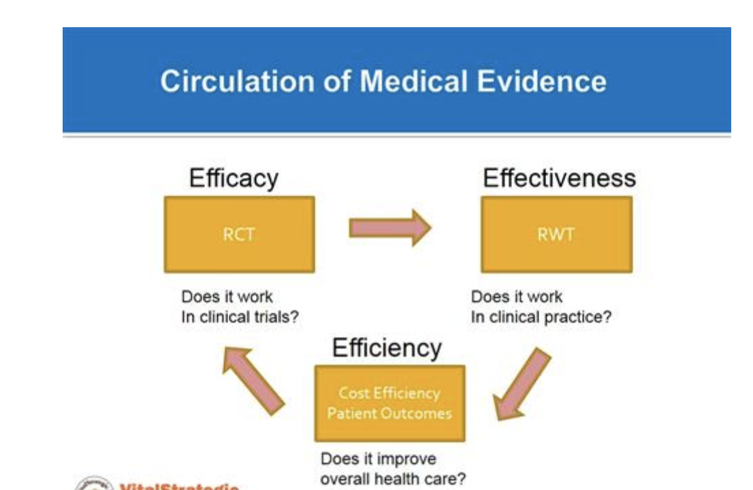
EFFICACY of Medical Practice :
The probability of benefit to individuals in a defined population from a medical technology under ideal conditions of use
Efficacy is not often established on patients for whom the service is ultimately intended
EFFECTIVENESS of Medical Practice :
The Capability of producing a desired result , when something is deemed to be Effective/Working in a way Intended by Medical Service Systems
The primary Goal of this Approach is to reduce the range of uncertainty and to illustrate the limited utility of efficacy studies in the absence of effectiveness studies

Slide 7
EFFICACY AND EFFICIENCY MATRIX:

Slide 8
VARIATIONS in use of service :
Most commonly refers to different observed levels of per capita consumption of a service. Typically, variation studies do not concern themselves with the outcomes of care
Quality Assessment:
Different quality assessment methods are in use . Some of them may be:
Evaluating the Medical Process. Probably the greatest advances have come in ways to evaluate the process of medical care .
Criteria Maps , they provide a powerful tool for Quality assessment and Quality assurance programs with development of protocols for use by both physician and non physicians
Computer-based Information. Our ability to carry out secondary analyses on large data bases, such as insurance claims files, for quality assessment purposes has improved drastically
INTEGRATED MODEL and its REQUIREMENT
Ideally, we need a fully integrated system that accurately measure the efficacy of procedures or drugs, assay their effectiveness in the everyday world, examine per capita variations in their use, and even evaluate the quality of the care process in which use of these services is embedded in data collection and information dissemination

Slide 9
Why Image Diagnosis Efficacy?
Increase in expenditure in diagnostic Imaging
Unnecessary radiation exposure
Examination disagreement

Slide 10
6-tier Efficacy Model
Societal Efficacy
Patient Outcome Efficacy
Therapeutic Efficacy
Diagnostic Thinking Efficacy
Level
Diagnostic Accuracy Efficacy
Technical Efficacy
Notes:
Lower level accuracy is the guarantee for higher level.

Slide 11
Level 1: Technical Efficacy
High Quality Image:
MTF
Sharpness
Brightness
Contrast
Mottle
Time required for an optimal exposure

Slide 12
Innovation in Efficacy Model
Radiology:
(Best images
Accurate diagnoses)
Treat patients effectively:
Ultimate value

Slide 13
Level 2: Diagnosis Accuracy Efficacy
It is a joint function of the images and of an observer.
technical efficacy, contributes to diagnostic accuracy efficacy. But there may be a point beyond which improvement in technical efficacy no longer improves diagnostic accuracy efficacy.
ROC
Sensitivity
Specificity

Slide 14
Level 3: Diagnosis Thinking Efficacy
Image information content
Changes in Treatment
Diagnosis thinking Change

Slide 15
Level 3: Diagnosis Thinking Efficacy Methods
Empirical method : Differential Diagnosis
Prob(correct diagnosis)
Prob(correct diagnosis)
Image information
Notes:
Which is the mostly likely one.

Slide 16
Reasoning Foundations for Medical Diagnosis
Aim:
To know about the complicated reasoning processes that how the physician makes a medical diagnosis

Slide 17
Inherent Concepts for the theory:
Symbolic Logic
Probability
Value Theory

Slide 18
Symbolic Logic
combinations of signs and symptoms that the patient does and does not have in relation to possible combinations of diseases.

Slide 19
Probability
to determine which of these alternative disease complexes is "most likely" for this patient.

Slide 20
Value Theory
to choose that treatment which will maximize the chance of curing the patient under the ethical, social, economic, and moral constraints.

Slide 21
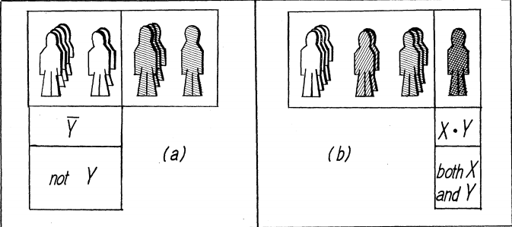
Calculus of symbolic logic
The symbols x, y are used to represent "attributes" a patient may have such as, a sign "fever" .

Slide 22
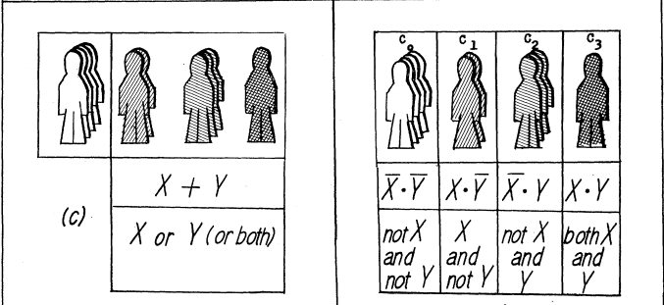
Calculus of symbolic logic
a patient must fit into one of these complexes. The complexes are mutually exclusive-that is, a particular patient can fit into only one of the cases at a time.

Slide 23
The fundamental formula of medical diagnosis
E
G
F
If medical knowledge E is known, then: if the patient presents symptoms G, he has disease f .

Slide 24
Level 4: Therapeutic Efficacy
New therapy
Avoid the need for therapy.

Slide 25
Level 5: Patient Outcome Efficacy
Cost comes into play
Methods:
RCT (random controlled trial)
Statistical Methods

Slide 26
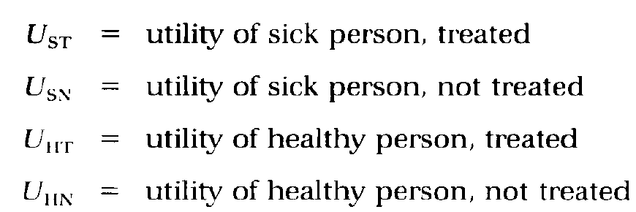
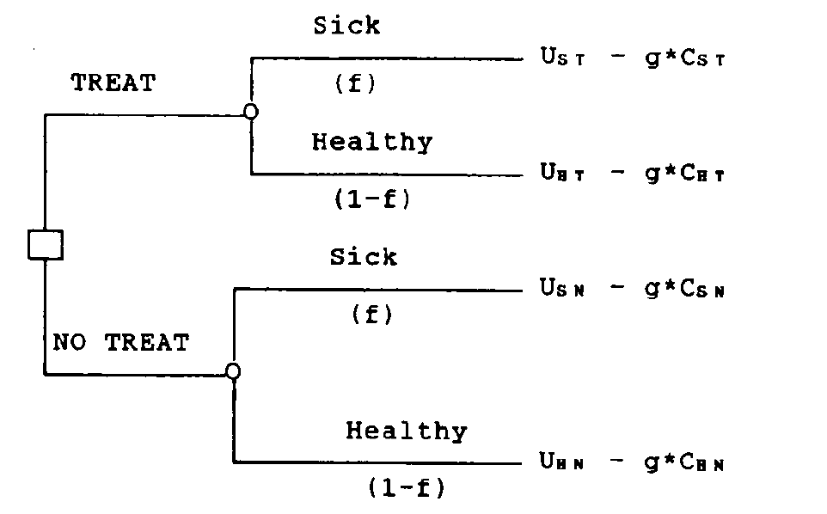
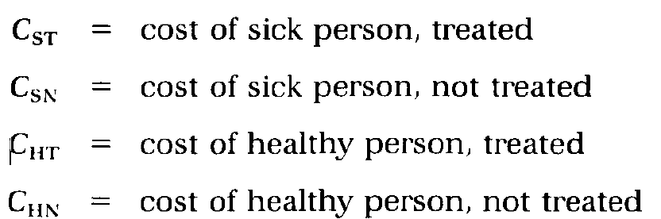
Phelps and Mushlin approach model
No diagnosis information provided.

Slide 27
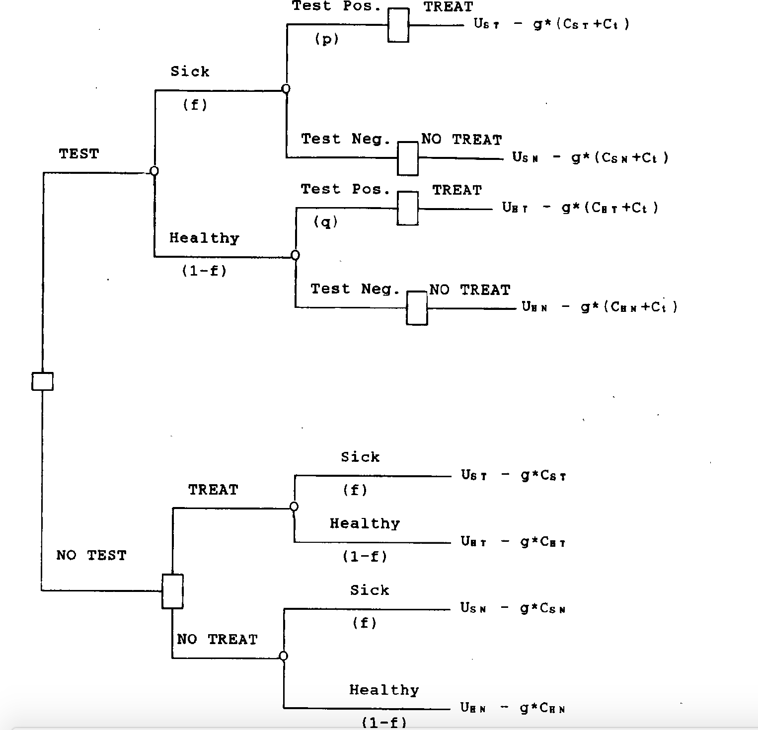
Diagnosis information provided

Slide 28
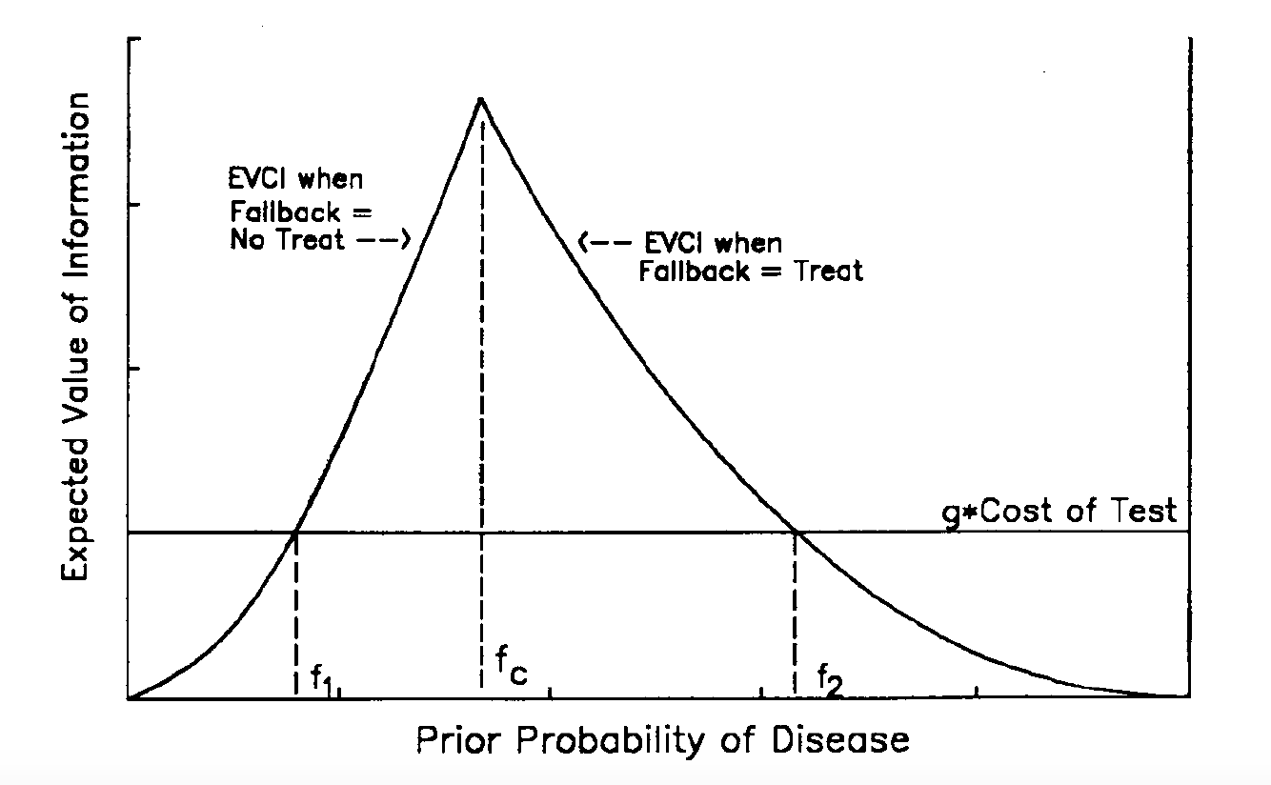
Expected value of clinical information

Slide 29
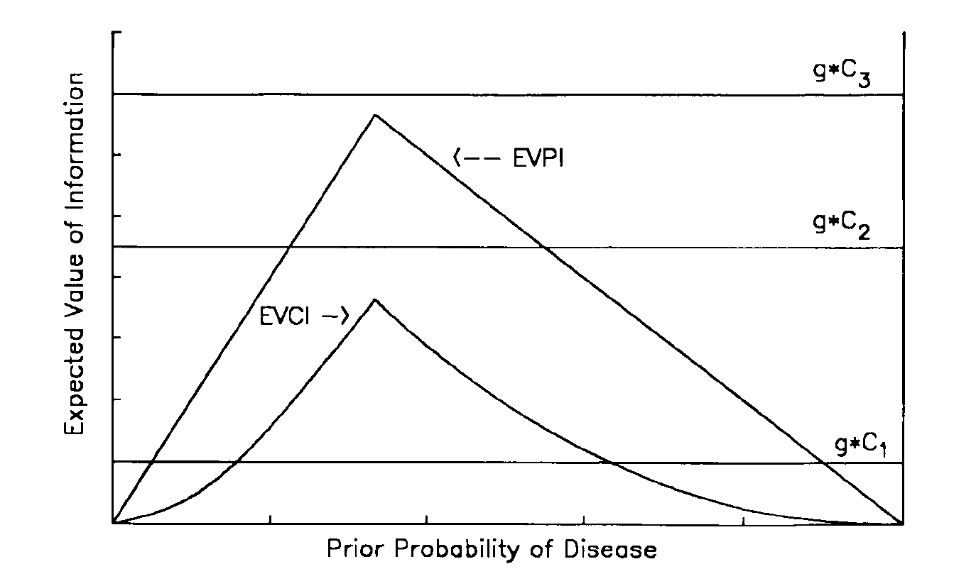
Hurdle I and Hurdle II comparison

Slide 30
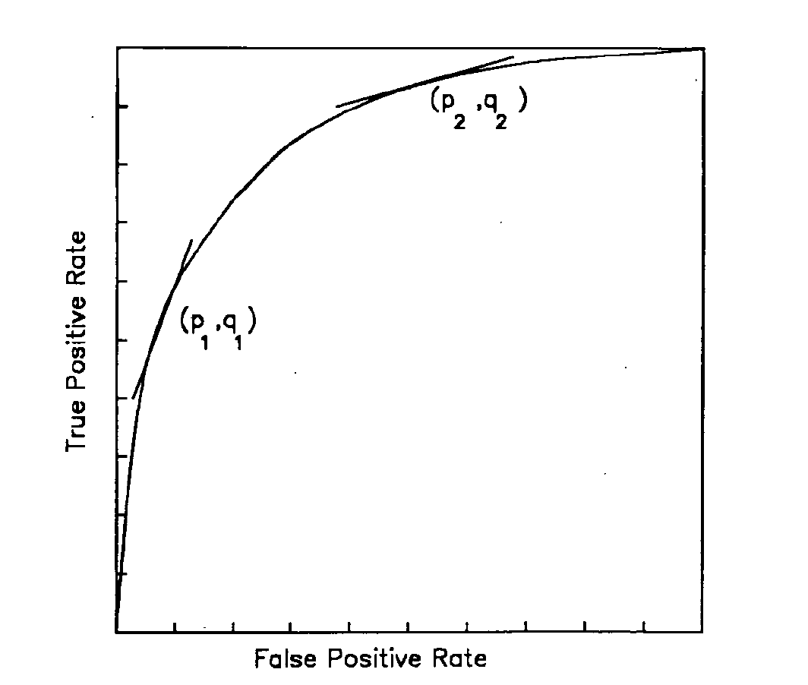
ROC curve

Slide 31
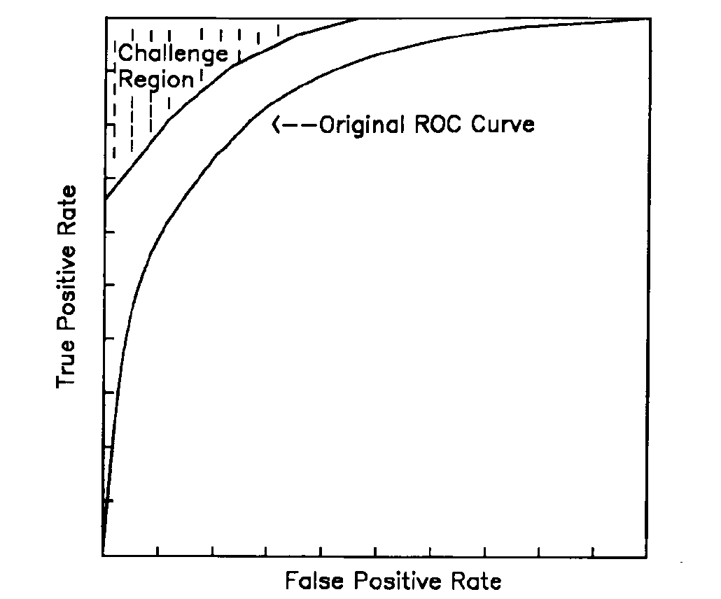
Challenge Region

Slide 32
Level 6: Societal Efficacy
Efficient use of societal resources
Introduction to new technology

Slide 33
Conclusion
Efficacy model evaluates diagnosis imaging in the whole process of patient treatment.
More research has been conducted in Level 1 and 2.

Slide 34
Papers for next presentation
[1] Gazelle, G. Scott, et al. "A framework for assessing the value of diagnostic imaging in the era of comparative effectiveness research." Radiology 261.3 (2011): 692-698.
[2] Lord, Sarah J., Les Irwig, and R. John Simes. "When is measuring sensitivity and specificity sufficient to evaluate a diagnostic test, and when do we need randomized trials?." Annals of internal medicine 144.11 (2006): 850-855.
[3] Verhaegen, Jorine, et al. "Accuracy of single progesterone test to predict early pregnancy outcome in women with pain or bleeding: meta-analysis of cohort studies." Bmj 345 (2012): e6077.
[4] Aboyans, Victor, et al. "2017 ESC Guidelines on the Diagnosis and Treatment of Peripheral Arterial Diseases, in collaboration with the European Society for Vascular Surgery (ESVS) Document covering atherosclerotic disease of extracranial carotid and vertebral, mesenteric, renal, upper and lower extremity arteries Endorsed by: the European Stroke Organization (ESO) The Task Force for the Diagnosis and Treatment of Peripheral Arterial Diseases of the European Society of Cardiology (ESC) and of the European Society for Vascular ...." European heart journal 39.9 (2017): 763-816.
[5] Met, Rosemarie, et al. "Diagnostic performance of computed tomography angiography in peripheral arterial disease: a systematic review and meta-analysis." Jama 301.4 (2009): 415-424.

Slide 35
Q&A THANK YOU

